Slide 1

Welcome back!
Studio S6
Ma Chi Kin Brian
e1121386@u.nus.edu
Tele: @bmanara

Slide 2
Recess week coming soon!

Slide 3
Agenda for Today
Admin Matters
Quick Recap
S6 Studio Worksheet
S6 In-Class Studio Worksheet (get ready for tough questions…)

Slide 4
Admin Matters
No S7 studio next week… due to recess week!
Use this time to catch up and get ready for midterms!
Tips for missions:
Read the question and understand what is asked from you!
Make use of what you have learned in the week. (List Processing Functions have been introduced, make use of them!)
Careless implementation can be costly ;-;

Slide 5
QUICK
RECAP
Trio of Higher Order Functions (map, filter and accumulate)
Trees
Tree Processing
Continuation-Passing Style (CPS)*
Tombstone Diagrams
Notes:
*not important/assessed

Slide 6
List Processing Functions
LISTS Documentation
https://docs.sourceacademy.org/LISTS/
Important to understand how all these functions work!
Use them to your advantage
Trio of HoF (VERY IMPORTANT TO UNDERSTAND):
map(f, xs)
filter(f, xs)
accumulate(f, initial, xs)

Slide 7
Recall:
map(f, xs)
filter(f, xs)
accumulate(f, initial, xs)
Notes:
map(f, xs)
Applies given function f to every element in xs
Returns a new list with every element being f(x)
filter(f, xs)
Returns a new list from original list xs, where all elements in the new list passed the predicate
accumulate(f, initial, xs)
Applies given function f from left to right
Resolves 2 elements at a time, starting from initial and first element of xs.
Takes the result of the above and the next element of xs, then resolves the 2 again.

Slide 8
List Processing Functions
map(f, xs)
Applies given function f to every element in xs
Returns a new list with every element being f(x)
filter(f, xs)
Returns a new list from original list xs, where all elements in the new list passed the predicate
accumulate(f, initial, xs)
Applies given function f from left to right
Resolves 2 elements at a time, starting from initial and first element of xs.
Takes the result of the above and the next element of xs, then resolves the 2 again.

Slide 9
Trees
Recall: List Discipline
Definition: ?
Notes:
Definition: A list is either null or a pair whose tail is a list

Slide 10
Trees
Recall: List Discipline
Definition: A list is either null or a pair whose tail is a list

Slide 11
Trees
Recall: List Discipline
Definition: A list is either null or a pair whose tail is a list
Tree Discipline
Definition: ?
Notes:
Definition: A tree of a certain data type is a list whose elements are of that data type, or trees of that data type.

Slide 12
Trees
Recall: List Discipline
Definition: A list is either null or a pair whose tail is a list
Tree Discipline
Definition: A tree of a certain data type is a list whose elements are of that data type, or trees of that data type.
Definitions of both are recursive in nature…

Slide 13
Trees
Recall: List Discipline
Definition: A list is either null or a pair whose tail is a list
Tree Discipline
Definition: A tree of a certain data type is a list whose elements are of that data type, or trees of that data type.
Note: We do not consider null and pair as “certain data type”, therefore we cannot have trees of nulls or trees of pairs.

Slide 14
Trees
Recall: List Discipline
Definition: A list is either null or a pair whose tail is a list
Tree Discipline
Alternate Definition: A tree of a certain data type is:
either null
or a pair
whose tail is a tree
whose head is a:
either of that data type
or a tree of that data type

Slide 15

Trees
Which one is not a tree?

Slide 16
Trees
Trick Question!
All four of them are trees!

Slide 17
Tree Processing: Mapping over trees
How do we map over trees?
Notes:
If the element is a list, go inside the list and map over all elements
Else, if it is a value, apply the function to it

Slide 18
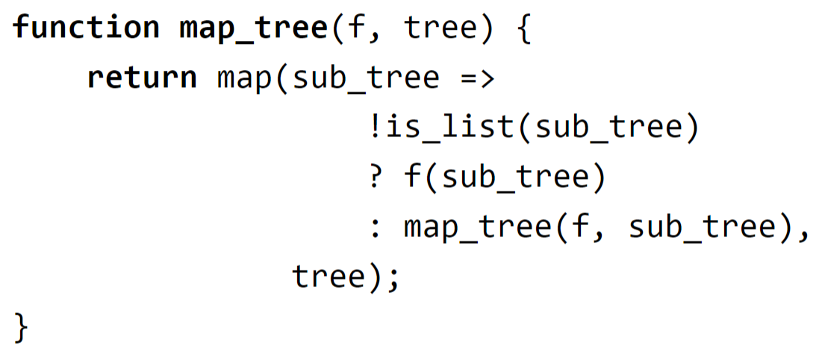
Tree Processing: Mapping over trees
How do we map over trees?
If the element is a list, go inside the list and map over all elements
Else, if it is a value, apply the function to it

Slide 19
Continuation-Passing Style (CPS)
Not examinable/assessed
Just a bonus topic!
Will not go through since it is not tested.
Essentially, it
Can turn any function to be iterative!
In some cases, it can be really hard to do so though…

Slide 20
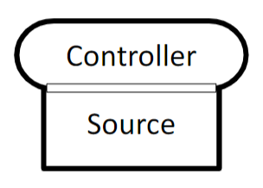
Tombstone Diagrams
Programs
Program “Controller” that is written in Source.

Slide 21
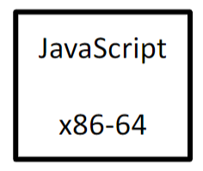
Tombstone Diagrams
Interpreters
Program that executes another program.
Source Language: Language that interpreter is written in.
Target Language: Language in which interpreter can execute.
Interpreter for JavaScript, written in x86-64 machine code

Slide 22
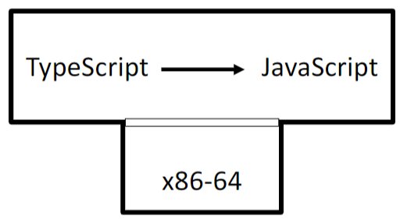
Tombstone Diagrams
Compilers
A program that translates from one language to another language.
TypeScript to JavaScript compiler,
written in x86-64 machine code

Slide 23
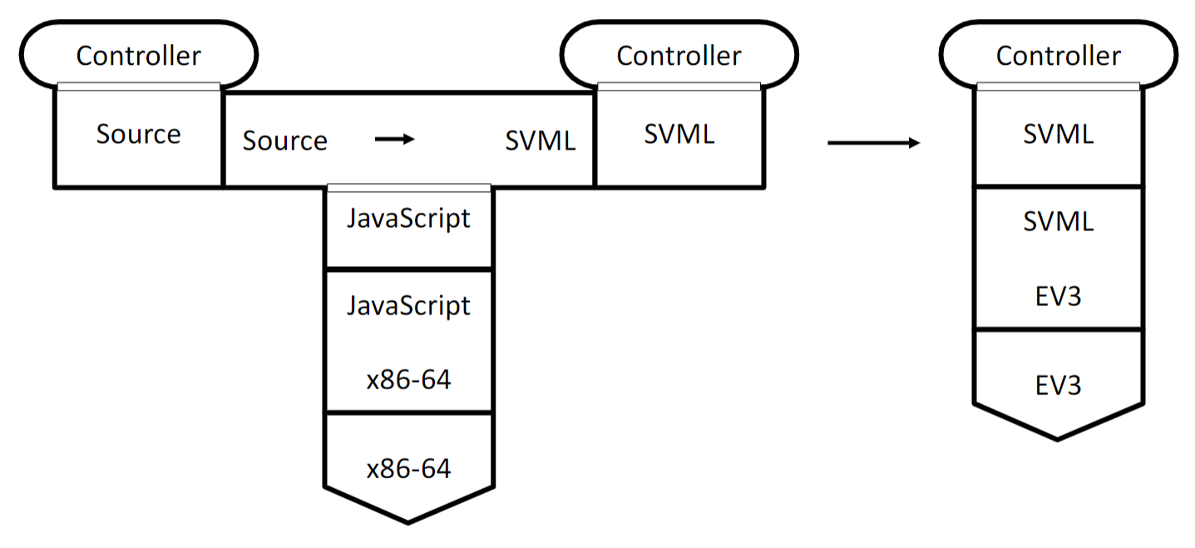
Tombstone Diagrams
Putting it all together…

Slide 24
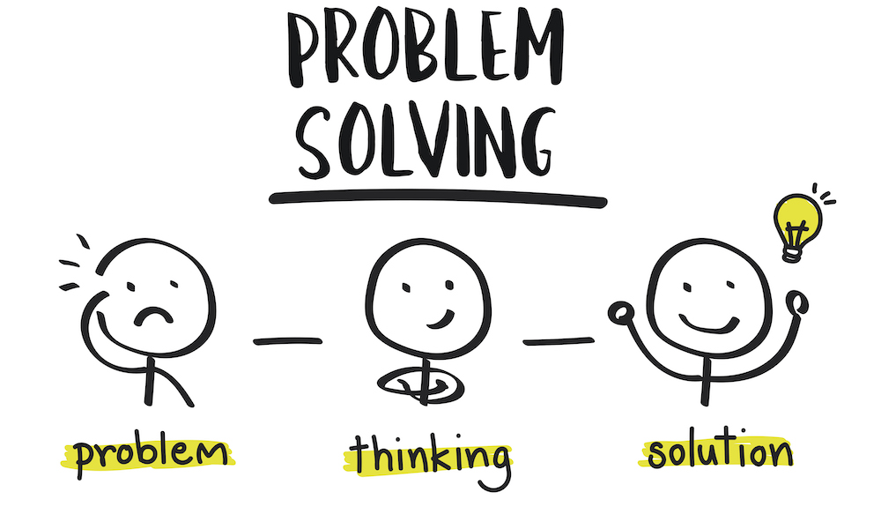
Problem Solving &
List Processing
S6 Studio Sheet

Slide 25
Problem Solving Techniques
Try to see the simplest cases.
If possible, think of some example base cases that could work.
Start with simple examples.
In Q3, try with a small list of coins, with a small x, and see how to work it out…
Think about which functions can help you do what you need!
map, filter, accumulate, remove, list_ref… the list goes on…
(My personal opinion, your technique might be a lot better. Do share yours!)

Slide 26
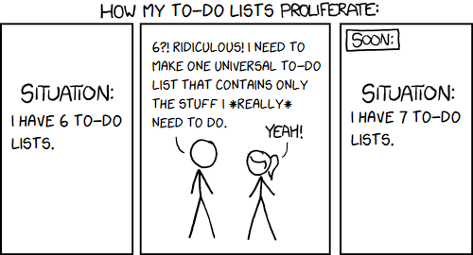
More List Processing…
S6 In-class Studio Sheet

Slide 27
See you next next week!
Slides will be uploaded to the google drive.

